Slide 1




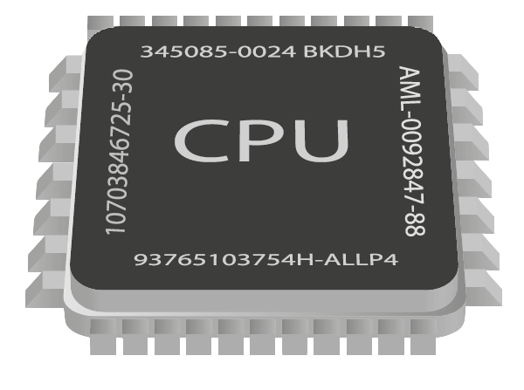
Asynchronous Programming
Writing Asynchronous Code in C#
call 73B5A920
mov ecx,5
nop
Advanced C#
SoftUni Team
Technical Trainers
Software University
http://softuni.bg

Slide 2

Table of Contents
Synchronous vs Asynchronous Code
Benefits and Drawbacks
Threads in C#
Tasks in C#
What are Tasks?
async and await
How does the OS achieve concurrency?

Slide 3

Synchronous Code

Slide 4
Synchronous Programming
Executing program components sequentially
i.e. "Sequential programming"
Actions happen one after another
Uses a single thread of a single process
Components wait for previous components to finish
Program resources are accessible at all points

Slide 5
Synchronous Code
Synchronous code is executed step by step
10 static void Main()
11 {
12 int n = int.Parse(Console.ReadLine());
13 PrintNumbersInRange(0, 10);
14 Console.WriteLine("Done.");
15 }
16
17 static void PrintNumbersInRange(int a, int b)
18 {
19 for (int i = a; i <= b; i++)
20 {
21 Console.WriteLine(i);
22 }
23 }
int n = int.Parse(..)
PrintNumbersInRange()
Console.WriteLine(..)
...

Slide 6
Synchronous Programming Drawbacks
If one component is blocked, the entire program is blocked
UI may become unresponsive
No utilization of multi-core systems
CPU-demanding tasks delay execution of all other tasks
Accessing resources blocks entire program
Especially problematic with web resources

Slide 7
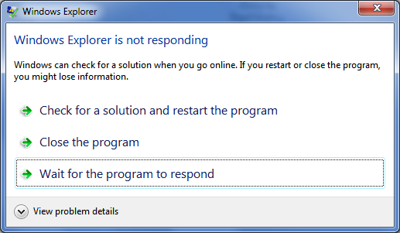
Synchronous Code
Live Demo

Slide 8
Asynchronous Code
Asynchronous programming allows the execution of other code without blocking the main execution
static void Main()
{
int n = int.Parse(Console.ReadLine());
PrintNumbersInRange(0, 10);
var task = Task.Run(() =>
PrintNumbersInRange(10, 20));
Console.WriteLine("Done.");
task.Wait();
}
int n = int.Parse(..)
for (0..10)
Console.WriteLine(..)
for (10..20)
Wait()

Slide 9
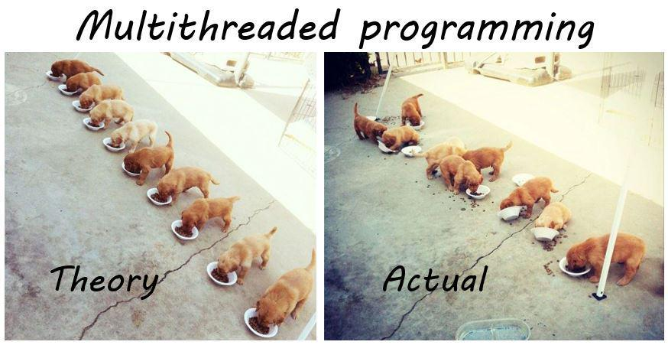
Threads

Slide 10

Threads
A thread is a fundamental unit of code execution
Commonly, programs use more than one thread
In .NET, there is always more than one thread
Each thread has a memory area associated with it known as a stack
Stores local variables
Stores the currently invoked methods in order of invocation

Slide 11
Threads in C#
Threads in C# can be created using the System.Thread class
Constructor accepts a method (delegate) to execute on a separate thread
Thread thread = new Thread(() =>
{
for (int i = 0; i < 10; i++)
{
Console.WriteLine(i);
}
});
thread.Start();

Slide 12
System.Thread
Start() – schedules the thread for execution
Join() – waits for the thread to finish its work (blocks the calling thread)
Abort() – terminates the thread
static void Main()
{
Thread primesThread = new Thread(() => PrintPrimesInRange(10, 100000));
primesThread.Start();
Console.WriteLine("Waiting for thread to finish work...");
primesThread.Join();
}

Slide 13
Thread – Example
static void Main()
{
Thread primesThread = new Thread(() => PrintPrimesInRange(10, 100000));
primesThread.Start();
Console.WriteLine("What should I do?");
while (true)
{
string command = Console.ReadLine();
if (command == "exit")
{
break;
}
}
primesThread.Join();
}
Console interface
remains unblocked

Slide 14
Thread Stack
Each thread has its own stack
The start (bottom) of the stack is the method from which the thread began execution
Each method (frame) stores local variables
...
IsPrime()
PrintAllPrimes()
Main()
...
IsValidUrl
DownloadAsync
background thread
main thread

Slide 15

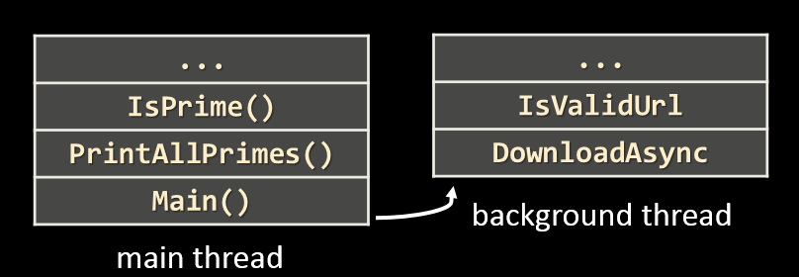
Debugging Thread Stacks
Live Demo

Slide 16

Thread Race Conditions
A race condition occurs when two or more threads access shared data and they try to change it at the same time
List<int> numbers = Enumerable.Range(0, 10000).ToList();
for (int i = 0; i < 4; i++)
{
new Thread(() =>
{
while (numbers.Count > 0)
{
int lastIndex = numbers.Count - 1;
numbers.RemoveAt(lastIndex);
}
}).Start();
}

Slide 17

Thread Safety
A thread-safe resource can be safely accessed by multiple threads
lock keyword grants access to only one thread at a time
Avoids race conditions
Blocks any other threads until the lock is released
lock (numbers)
{
if (numbers.Count == 0)
break;
int lastIndex = numbers.Count - 1;
numbers.RemoveAt(lastIndex);
}

Slide 18

Threads
Live Demo

Slide 19
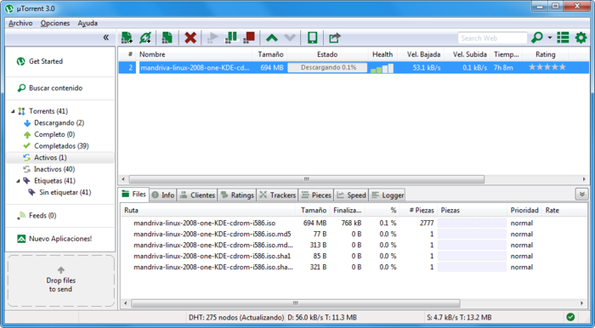
Asynchronous Programming – Benefits
If a component is blocked, other components still run
UI runs separately and always remains responsive
Utilization of multi-core systems
Each core executes one or more threads
CPU-demanding tasks run on "background" threads
Resource access runs on "background" threads

Slide 20
Asynchronous Programming – Drawbacks
Hard to know which code parts are running at a specific time
Harder than usual to debug
Have to protect resources
One thread uses a resource
Other threads must wait for the resource
Hard to synchronize resource access
Deadlocks can occur

Slide 21


Tasks in C#
Task Parallel Library

Slide 22
Tasks in C#
A task is a high-level representation of concurrent work
Does not block the main thread
May not run on a new thread (the CLR decides)
Offers several operations
Creating, running and returning result
Continuing another task (chaining several operations)
Proper exception handling
Progress/state reports

Slide 23
Creating Tasks in C#
Creating tasks can be done in several ways
Initialize a new Task object
Task.Run()
Task.Factory.StartNew() – enables additional task customization
Task task = new Task(() => { Console.WriteLine(""); });
Task.Run(() => TraverseMatrix());
Task.Factory.StartNew(() => CopyFileContents("got-s03ep1.avi"),
TaskCreationOptions.LongRunning);

Slide 24
Task API in C# – Example
static void Main()
{
SliceAsync("movie.avi", "Pieces", 5);
Console.WriteLine("Anything else?");
while (true)
{
Console.ReadLine();
}
}
static void SliceAsync(string sourceFile, string destinationPath, int parts)
{
Task.Run(() =>
{
Slice(sourceFile, destinationPath, parts);
});
}
Executes on a separate thread

Slide 25

Slicing Files with Tasks
Live Demo

Slide 26

Parallel Image Flips
Live Demo

Slide 27
Generic Tasks
Task<T> is a task that will return a result sometime in the future
Result blocks the calling thread until the task returns a result
Task<long> task = Task.Run<long>(() =>
{
var primes = PrimesInRange(0, 1000000);
return primes.Sum();
});
// ...
Console.WriteLine(task.Result);
Blocking operation

Slide 28
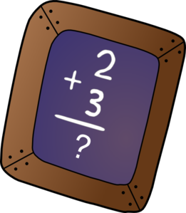
Primes Sum with Tasks
Live Demo

Slide 29
Task Exception Handling
Exceptions that have occurred within the body of a Task can be captured and handled outside of it
Unlike Threads, where exceptions must be handled within the thread
var task = SliceAsync(VideoPath, DestinationPath, 5);
try
{
var result = task.Result;
}
catch (AggregateException ex)
{
// Handle exception...
}
A collection of exceptions is thrown

Slide 30

Tasks in C#
Live Demo

Slide 31
Tasks with async and await
The keywords async and await are always used together
async hints the compiler that the method might run in parallel
Does not make a method run asynchronously (await makes it)
Tells the compiler "this method could wait for a resource or operation"
If it starts waiting, return to the calling method and continue work
When the wait is over, go back to called method and execute the remaining code
static async void SliceFileAsync(string file, int parts)

Slide 32
Tasks with async and await (2)
await is used in a method which has the async keyword
Saves the context in a state machine
Marks waiting for a resource (a task to complete)
Resource should be a Task<T>
Returns T result from Task<T> when it completes
await DownloadStringTaskAsync("http://softuni.bg");
Returns Task<string>

Slide 33
async and await – Example
static void Main()
{
DownloadFileAsync(FileUrl, "book.pdf");
...
}
static async void DownloadFileAsync(string url, string fileName)
{
Console.WriteLine("Downloading...");
await Task.Run(() =>
{
using (WebClient client = new WebClient())
{
client.DownloadFile(url, fileName);
}
});
Console.WriteLine("Download successful.");
Process.Start(fileName);
}
The calling thread exits the method on await
Everything after that is executed on another thread

Slide 34

UI Event Loop
The UI gets events from the OS and processes them
The UI runs on a single thread, so the processing should not block
Get Event from OS
Schedule code to execute on UI context
Call Async Method
Task
State: Waiting
State: Complete
Process Event
Return to UI loop

Slide 35
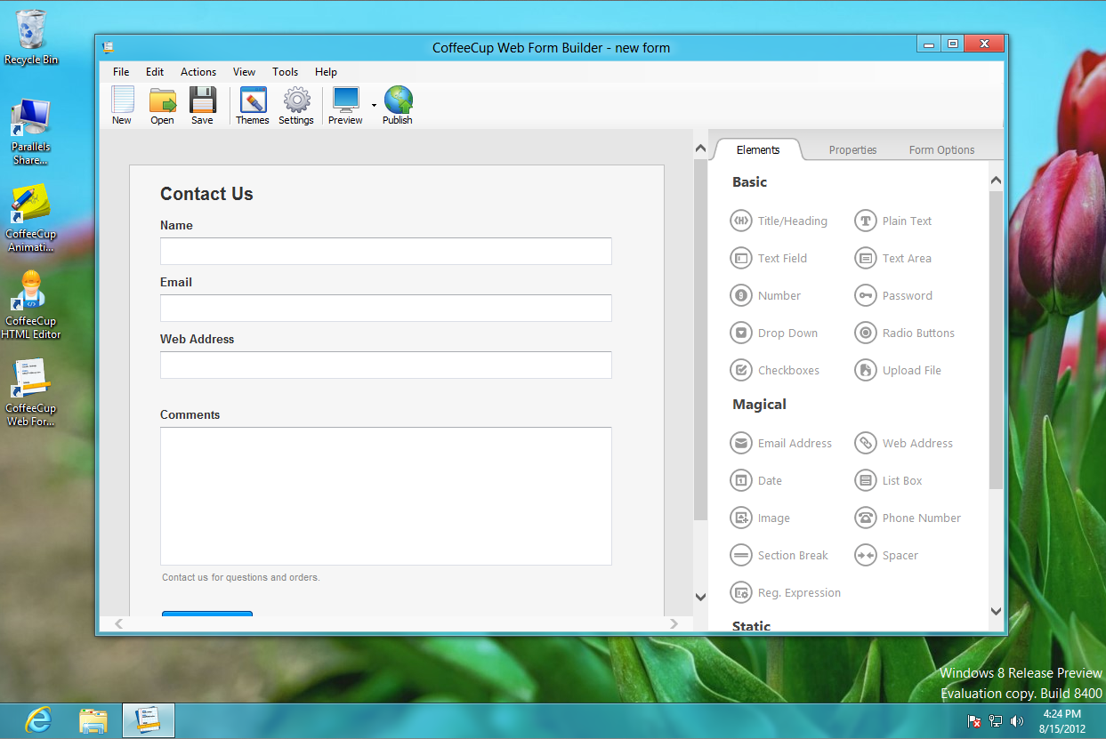
Graphical User Interface
Live Demo

Slide 36
Tasks with async and await
Live Demo

Slide 37
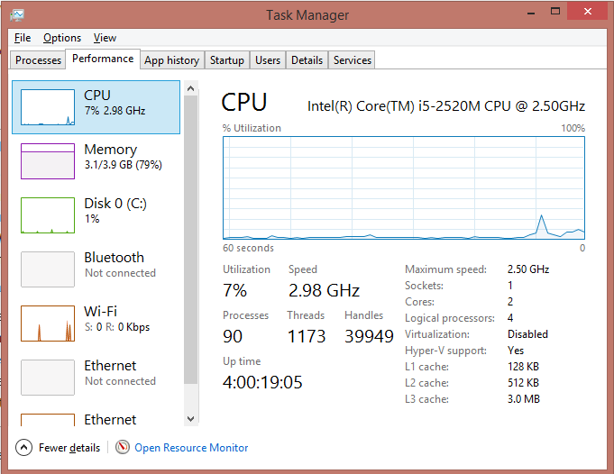
Operating System Concurrency

Slide 38
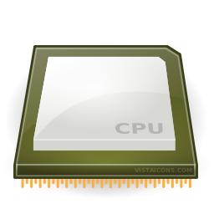
Instruction Execution
Each program's code is translated to CPU instructions
Program.cs
int a = 5;
int b = 4;
Console.WriteLine(a + b);
Compilation
Program.exe
Single-Core CPU
00DA2655 mov dword ptr [ebp-40h],5
00DA265C mov dword ptr [ebp-44h],4
00DA2663 mov ecx,dword ptr [ebp-40h]
00DA2666 add ecx,dword ptr [ebp-44h]
00DA2669 call 73B5A920
00DA266E nop
Instructions are executed one by one

Slide 39
Multi-Tasking
A computer can run many processes (applications) at once
But its CPU (single-core) can only execute one instruction at a time
Parellelism is achieved by the operating system's scheduler
Grants each thread a small interval of time to run
Thread switching is achieved via hardware interrupts
The motherboard clock sends interrupts to the CPU every few ms
program.exe
chrome.exe
winamp.exe
system.exe
program.exe
...
0 5 10 15 20 25 ms

Slide 40

Helpful Resources
SoftUni Seminar on Concurrent C#
Article on Task API
Stephen Cleary Blog
https://softuni.bg/trainings/1021/Concurrent-Programming-in-C-Sharp
http://www.infoq.com/articles/Tasks-Async-Await
http://blog.stephencleary.com/

Slide 41
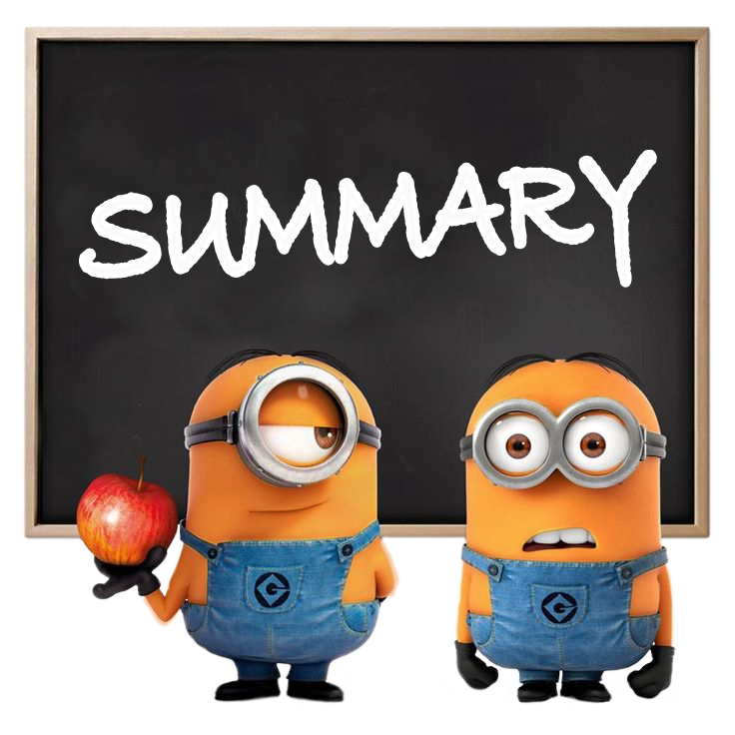
Summary
A thread is a unit of code execution
Each thread has its own call stack
Multithreading means a program can do several
operations in parallel by using many threads
Used to offload CPU-demanding work so the main thread does not block
Can lead to synchronization issues and unexpected results
Tasks facilitate the work with multithreading
async and await keywords

Slide 42










Asynchronous Programming
http://softuni.bg/courses/advanced-csharp

Slide 43

License
This course (slides, examples, demos, videos, homework, etc.) is licensed under the "Creative Commons Attribution-NonCommercial-ShareAlike 4.0 International" license
Attribution: this work may contain portions from
"C# Fundamentals – Part 2" course by Telerik Academy under CC-BY-NC-SA license

Slide 44






Free Trainings @ Software University
Software University Foundation – softuni.org
Software University – High-Quality Education, Profession and Job for Software Developers
softuni.bg
Software University @ Facebook
facebook.com/SoftwareUniversity
Software University @ YouTube
youtube.com/SoftwareUniversity
Software University Forums – forum.softuni.bg

